Slide 1
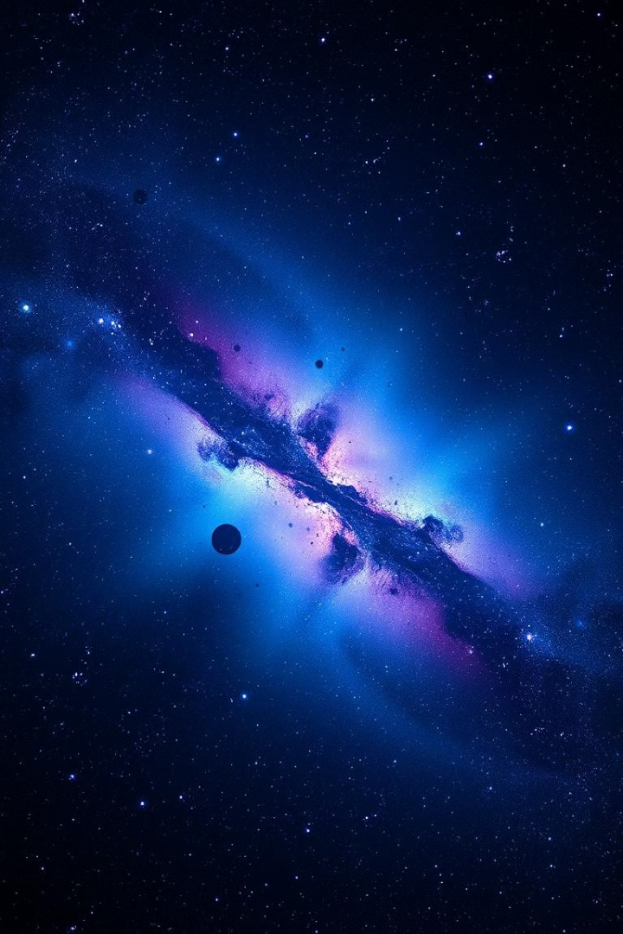

Star Identifier App
By :
Liron Cohen
Alon Suissa

Slide 2

About the system
Our project is to create an application that processes an input image and by using an astronomical catalog classifies the detected objects and returns an image with the names of the stars

Slide 3

Application building process
איפיון
עיצוב
DATABASE
פיתוח
בדיקת איכות
השקת האפליקציה

Slide 4



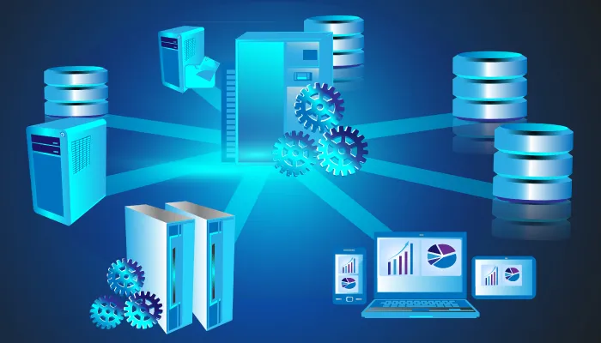



DataBase

Slide 5
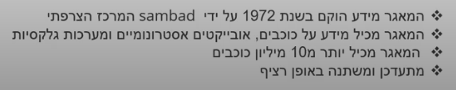
SiMBAD

Slide 6
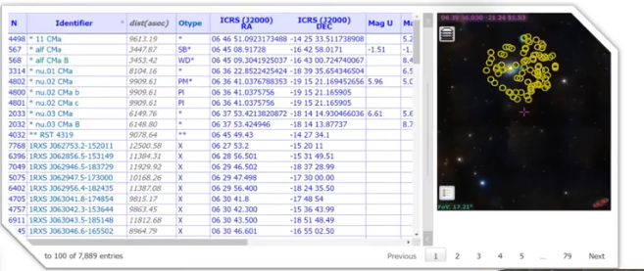
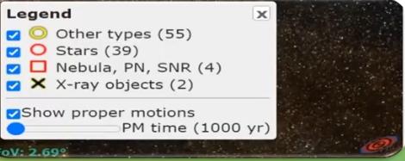
SiMBAD

Slide 7

About The App
The App accepts astronomical images (photos of stars)
, detects stars in them using computer vision techniques, and then optionally used API Astrometry to uploads the image to Astrometry.net - to determine the astronomical coordinates
after that it return the names of stars at those locations from SIMBAD database catalog.

Slide 8





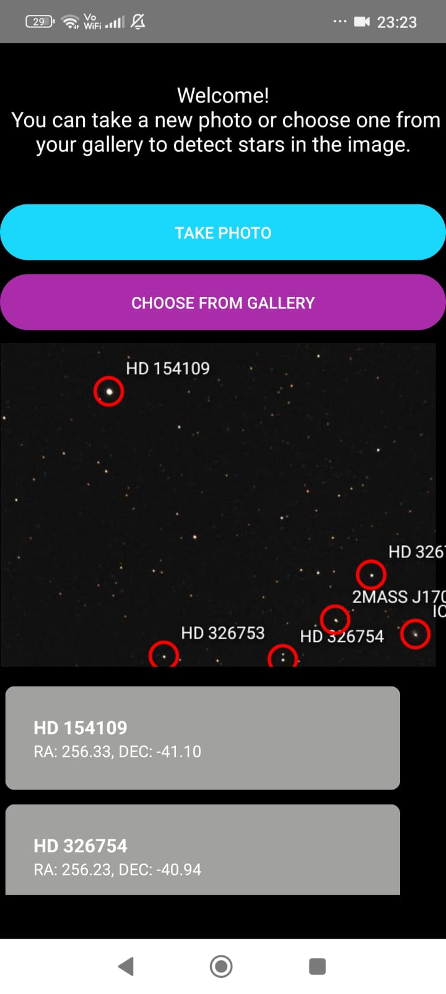
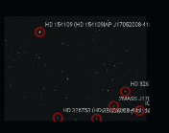
Implementation
A client sends an HTTP POST to /upload with an image of the night sky (stars)
Star Detection
API Astrometry
SiMBAD Database Catalog
*Detect stars in image pixels (OpenCV's HoughCircles to detect stars (or at least, bright circular features in the image, which often correspond to stars in astronomical FITS images))
*Takes a list of star coordinates in pixels (x, y).
*(Convert pixel coordinates → RA/Dec)
Converts those pixel coordinates into celestial sky coordinates (RA, DEC). that do by astrometry (get WCS, world coordinates system)
*Uses the SIMBAD database catalog to find the names of stars at those locations(For each star RA/Dec, query SIMBAD to get the star's common name)
*User uplode image
Annotated Output
Img Client Output
.*Annotate image with these star names
*Annotates each star with its celestial coordinates and name
*Saves the results in a human-readable .txt file.
Show to The Client The Img with Stars Names,Their Locations (RA, DEC).

Slide 9
The Flask server in that project is a Python program that listens for HTTP requests from other programs (like a web browser or Android app) and responds to them.
Flask server using the Flask library in Python.
Server Process-
1-A client sends an HTTP REQUEST to /upload with an image of the night sky (stars)
2-The server receives the request, processes it
2-The server checks the image is valid, saves it and sends a response back.
3-The image is processed to detect stars (using OpenCV)
4-The image is uploaded to Astrometry.net to resolve star names and coordinates
5-Server fetches celestial info and names of star from SIMBAD
6-The server responds with the list of stars, including x, y, and star name(a JSON response with that list)

Slide 10
Server Process Flow: From Request to Response
Client Request
1
A client sends an HTTP POST request to the /upload endpoint with an image of the night sky.
2
Server Reception & Validation
The server receives and validates the image, saving it temporarily before sending an initial response back to the client.
Star Detection
3
The saved image is processed using OpenCV to accurately detect and extract star features.
4
Astrometry.net Upload
The detected star image data is then uploaded to Astrometry.net for celestial coordinate resolution.
SIMBAD Fetch
5
Celestial information and star names are fetched from the SIMBAD database based on Astrometry.net's results.
6
JSON Response
Finally, the server constructs and sends a JSON response containing the list of stars, their x, y coordinates, and names.
The server's workflow is a meticulously orchestrated sequence of operations designed for efficiency and accuracy. It begins with the reception of an image from a client, followed by rigorous validation and local storage. The image then enters the core processing pipeline, undergoing star detection, external API calls to Astrometry.net and SIMBAD, and culminates in a structured JSON response to the client. This robust process ensures timely and accurate astronomical data delivery.

Slide 11
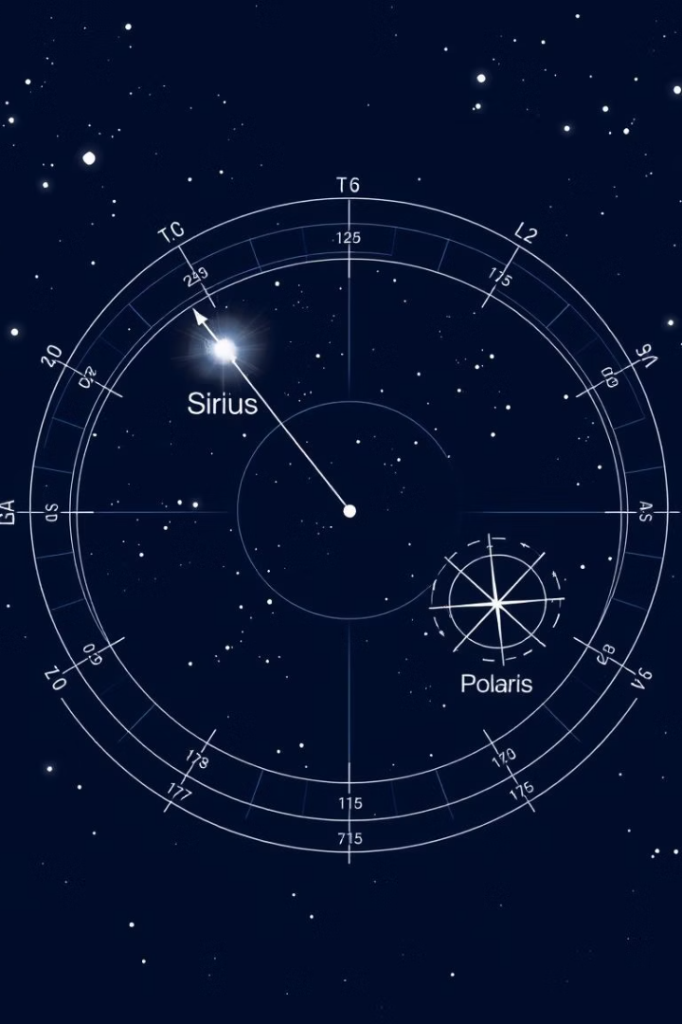
Example Output: A Glimpse into the Data
123.0, 456.0 -> RA: 83.82208, DEC: -5.39111, Name: BETELGEUSE (HD 39801, HIP 27989)789.5, 123.4 -> RA: 299.78901, DEC: 38.78901, Name: VEGA (ALPHA LYRAE, HR 7001)
load the image
blur it to smooth out noise.
HoughCircles tries to find circular bright features, which you assume are stars.
collect their pixel coordinates (x, y) into a list.
then pass those coordinates into annotate_stars(...).

Slide 12
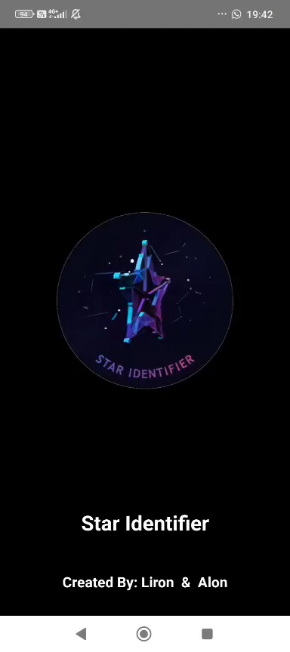
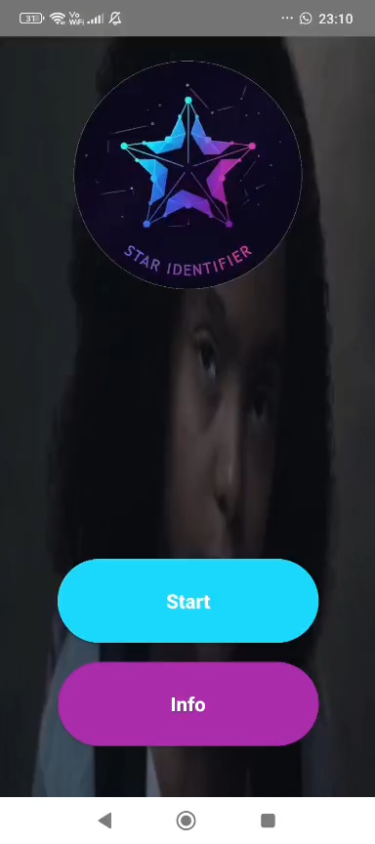
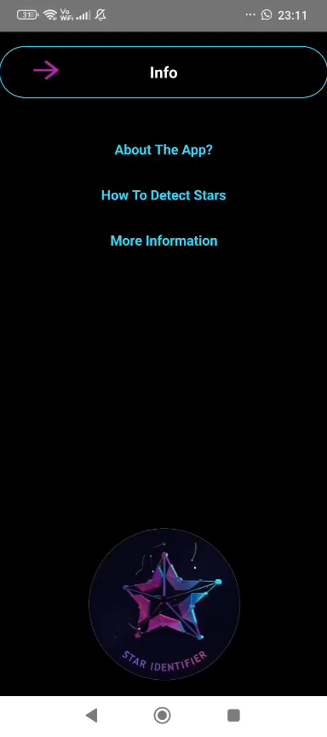
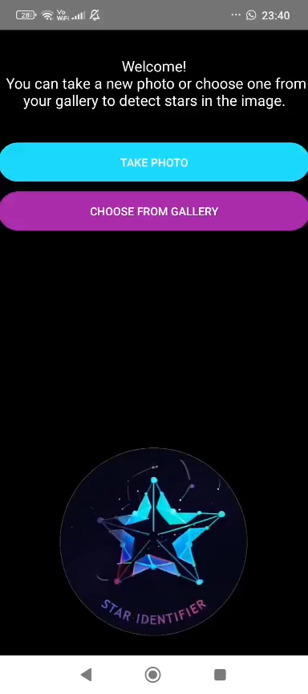
System Screens

Slide 13
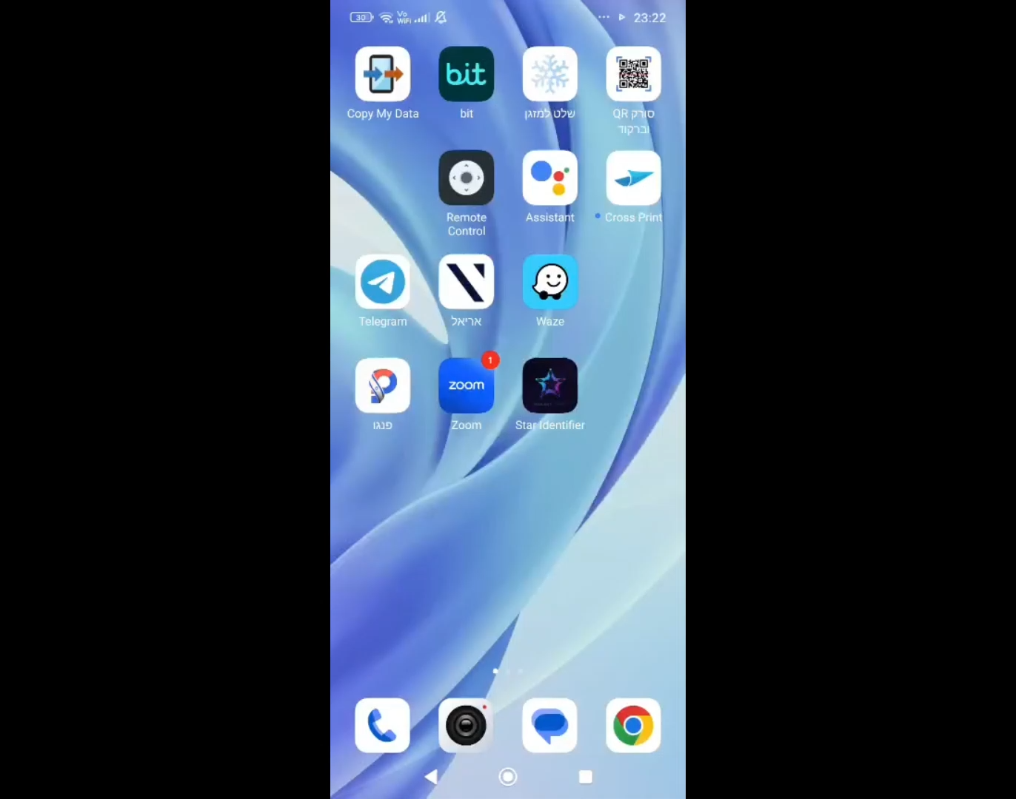
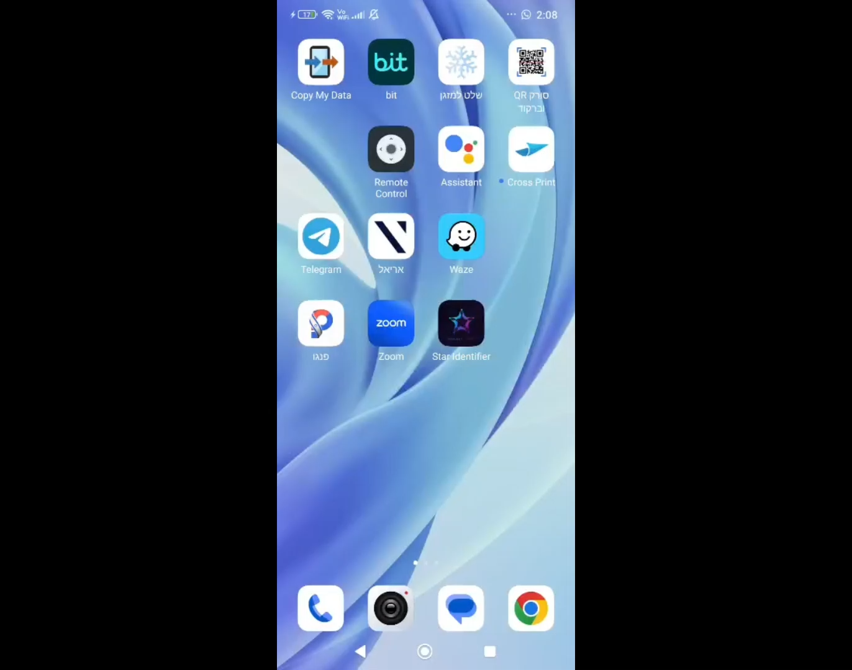
Running App Video

Slide 14

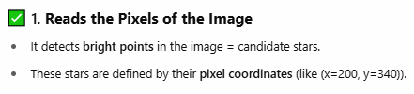
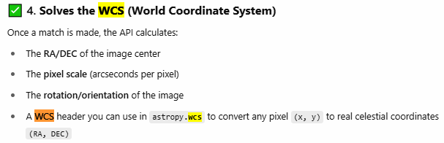
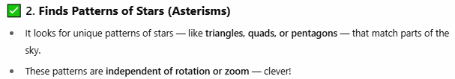
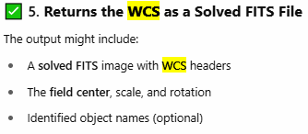
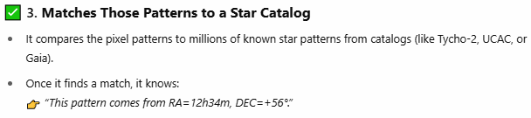
HOW THE ASTROMETRY API WORKS — STEP BY STEP
When you upload a raw sky image (e.g., .jpg, .png, .fits), the API performs blind astrometric solving, meaning:

Slide 15

Star Identification: Naming the Cosmos
SIMBAD Database Query
Common Star Names
Annotated Output
For each star's RA/DEC coordinates, StarSense queries the SIMBAD astronomical database. SIMBAD is a vast repository of information on celestial objects, allowing us to retrieve common names, catalog designations, and other relevant data for identified stars.
The system prioritizes fetching common star names like "BETELGEUSE" to make the output more human-readable and accessible, alongside official catalog identifiers like HD and HIP numbers.
Each detected star in the image is annotated with its celestial coordinates (RA, DEC) and its resolved name. This information is then compiled and saved in a user-friendly .txt file for easy review and analysis.
Once celestial coordinates are established, the system focuses on identifying the stars. By querying the SIMBAD database, we can associate each set of coordinates with known celestial objects, providing not just their precise location but also their familiar names. This detailed annotation enhances the utility of the processed images for both scientific and educational purposes.

Slide 16



The Flask Web Server: Enabling Seamless Interaction
Server Setup
The project includes a Flask web server, a Python program designed to handle HTTP requests from clients, enabling dynamic interaction.
Image Upload Endpoint
A dedicated /upload endpoint is established to receive HTTP POST requests containing astronomical images from users.
JSON Response
Upon successful processing, the server returns the annotated star data in a structured JSON format, making it easy for client applications to parse and utilize.
The Flask web server is the backbone of our system, facilitating seamless interaction between users and the image processing pipeline. It acts as an API endpoint, allowing various client applications, such as web browsers or mobile apps, to upload astronomical images for analysis. The server handles all the heavy lifting, from initial image validation to returning detailed star information in an easily consumable JSON format.

Slide 17
Key Takeaways & Future Directions
1
2
Automated Analysis
Developer Utility
StarSense automates the complex process of identifying stars in astronomical images.
Provides a robust API for developers to integrate astronomical image processing into their applications.
3
Enhanced Accuracy
Leverages industry-standard tools like OpenCV and Astrometry.net for precise results.
StarSense represents a significant step forward in automated astronomical image analysis, offering a powerful tool for developers and enthusiasts alike. The project's modular design, combining robust computer vision with external astronomical databases via a Flask server, ensures both accuracy and scalability. Future enhancements could include real-time processing, support for more image formats, and integration with additional astronomical data sources to further enrich the analysis capabilities.

